Slide 1
Compromising Kubernetes Cluster by Exploiting RBAC Permissions

Slide 2
Topics Covered This Week
Kubernetes architecture.
Implementation of kubernetes architecture.
Example or possible scenario of some attacks.

Slide 3
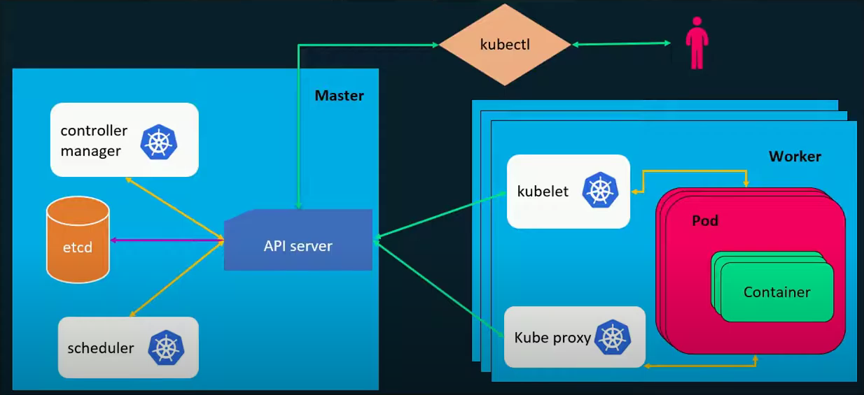
Kubernetes Architecture

Slide 4
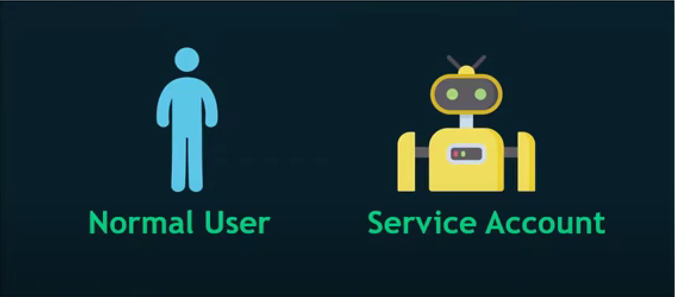
User Type
Notes:
A service account provides an identity for processes that run in a Pod.
Credential for Service account: Service account token

Slide 5
From Kubernetes.io
“When you create a pod, if you do not specify a service account, it is automatically assigned the default service account in the same namespace.”
It means we have the ability to specify a service account we want in any service account in the namespace.

Slide 6
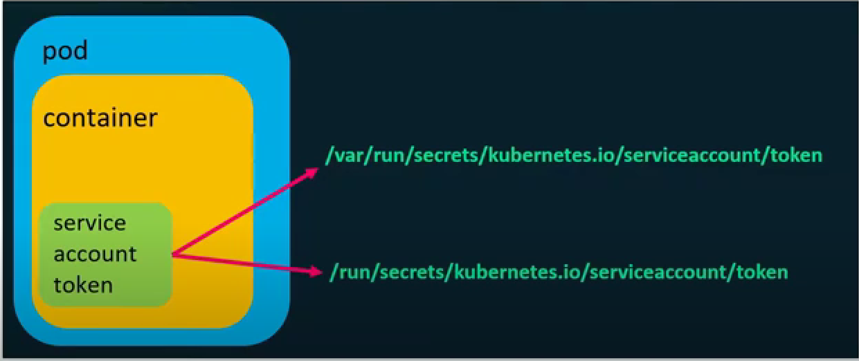
Service Account Token Location

Slide 7
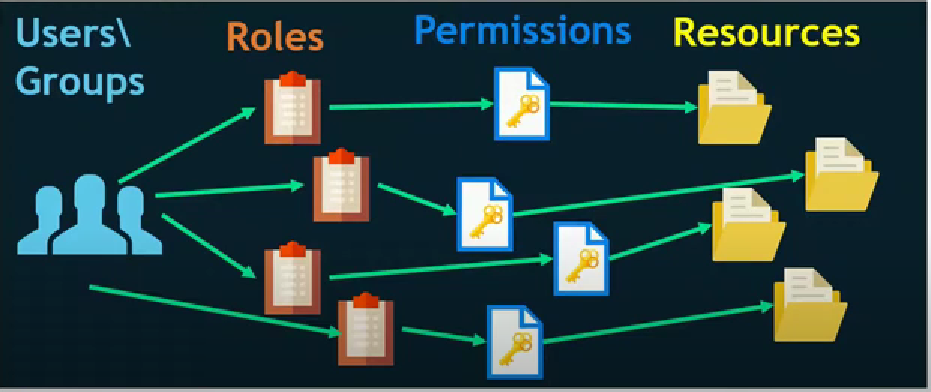
Role Based Access Control

Slide 8
RBAC in Kubernetes
Role: Sets permissions within a particular namespace.
ClusterRole: Sets permissions cluster-wide.
RoleBinding: Grants the permissions defined in a role to a user or set of users.
ClusterRoleBinding:Grants the permissions defined in a ClusterRole to a user or set of users.

Slide 9
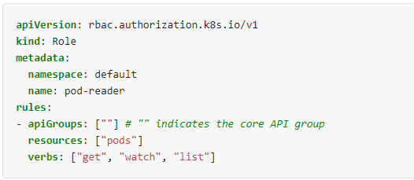
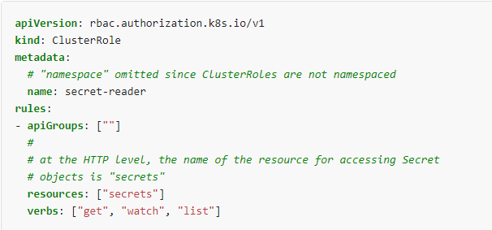
Role vs ClusterRole

Slide 10
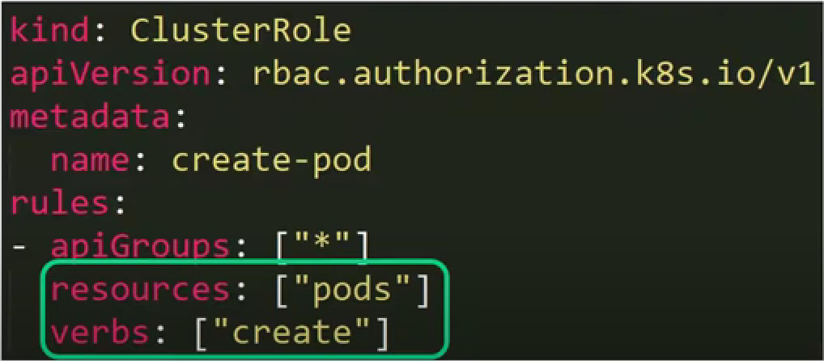
Possible Attack Scenario(1)

Slide 11
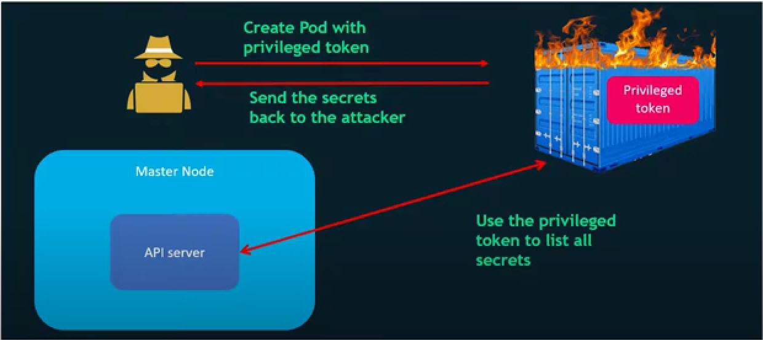
Possible Attack Scenario(1)
Notes:
Creating a “Hot pot” with privileged service account

Slide 12
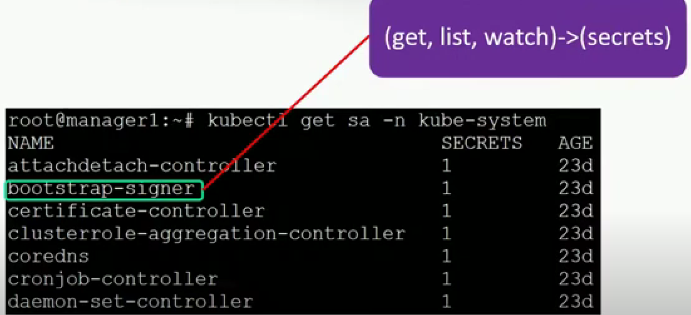
Possible Attack Scenario(1)

Slide 13
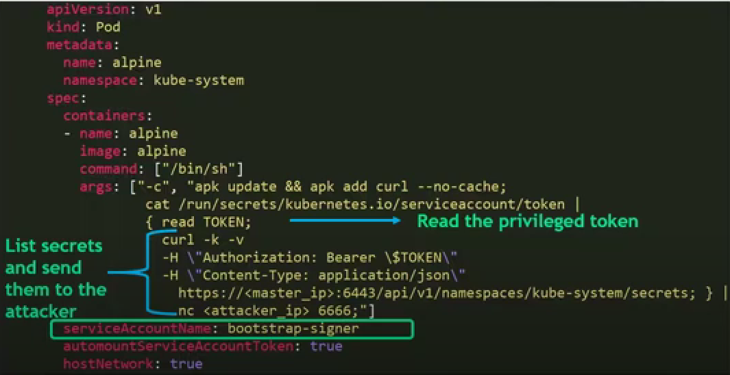
Possible Attack Scenario(1)

Slide 14
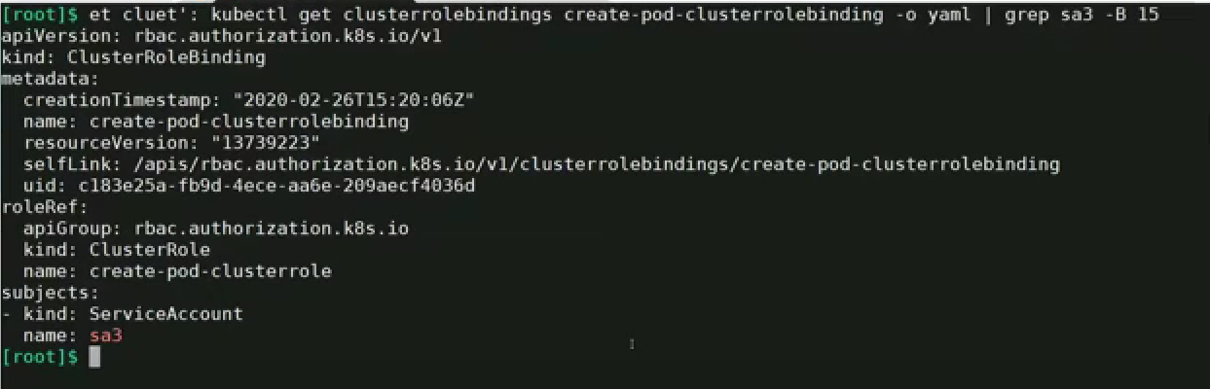
Possible Attack Scenario(1-Demo)

Slide 15
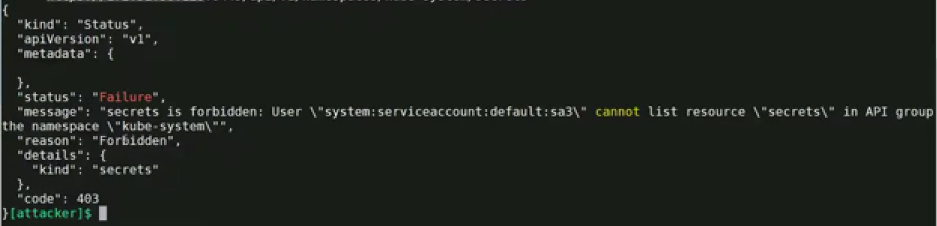
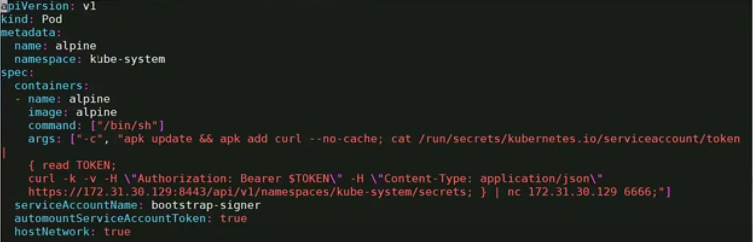
Possible Attack Scenario(1-Demo)

Slide 16
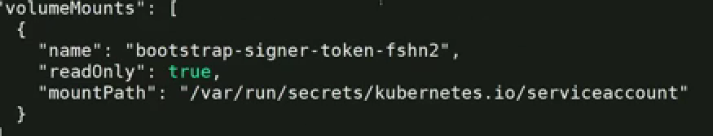
Possible Attack Scenario(1-Demo)
Notes:
To listen to a port: nc –vlp <port number>

Slide 17
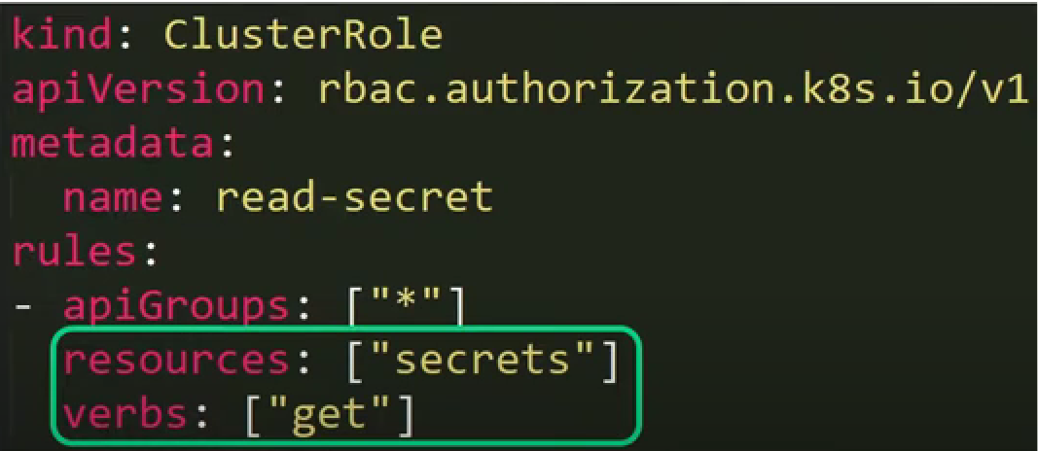
Brute Forcing Token IDs

Slide 18
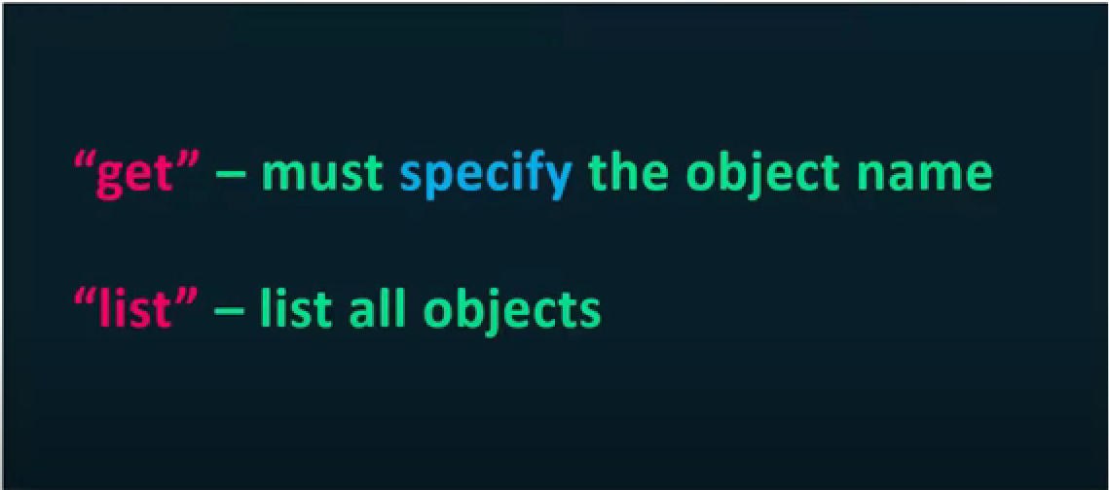
Brute Forcing Token IDs

Slide 19
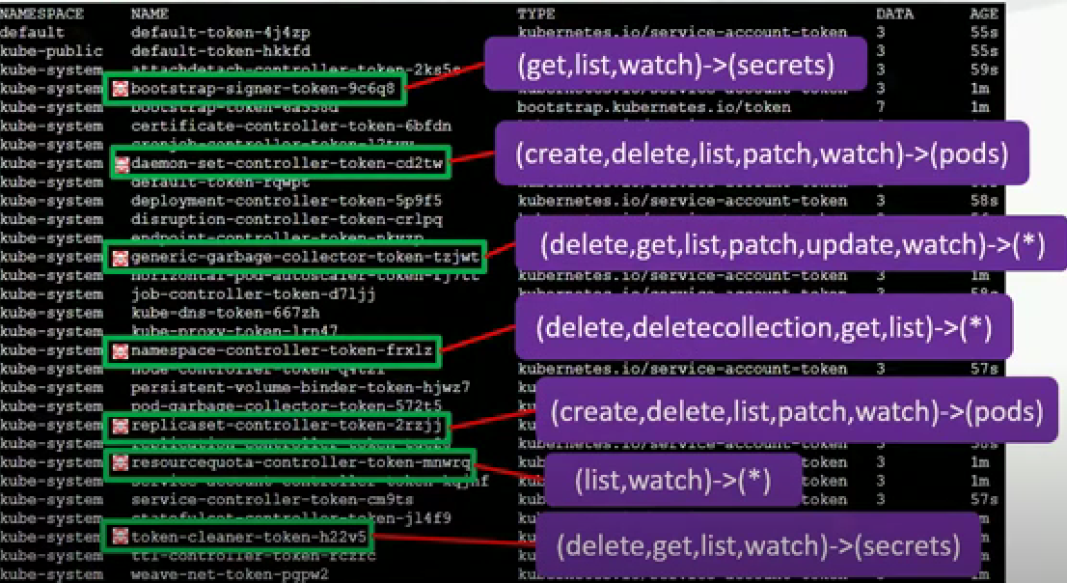
Brute Forcing Token IDs

Slide 20
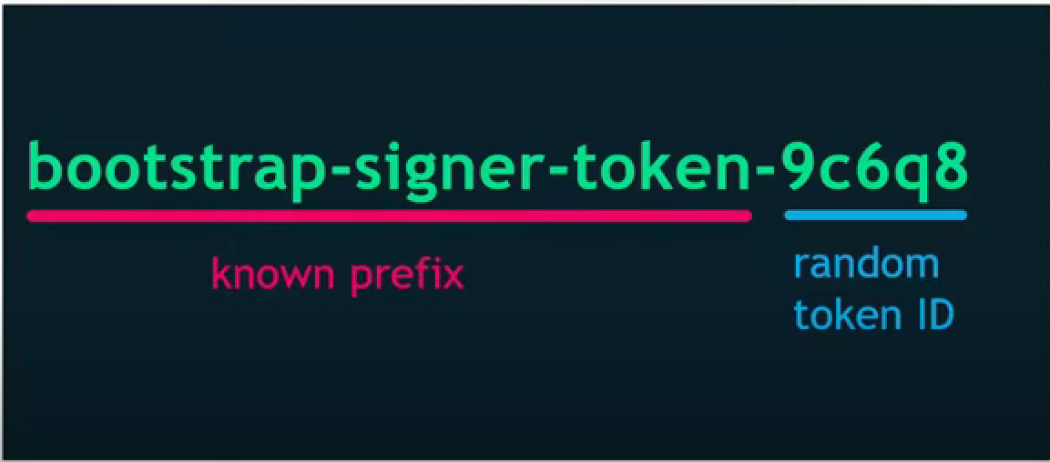
Brute Forcing Token IDs

Slide 21
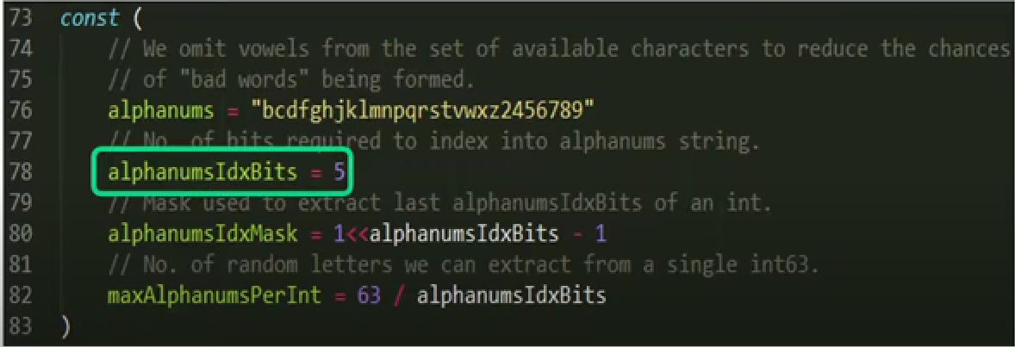
Brute Forcing Token IDs

Slide 22
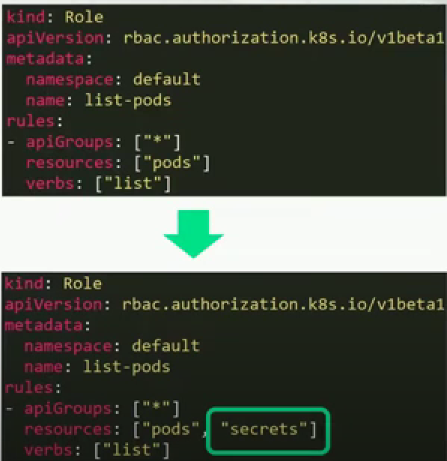
Prevention

